Slide 1
Database Management System
Ms.K. Anjali
Division Operation and Tuple relational Calculus

Slide 2
Division operation
The division operator is used for queries which involve the ‘all’.
R1 ÷ R2 = tuples of R1 associated with all tuples of R2.
Example
Retrieve the name of the subject that is taught in all courses.

Slide 3
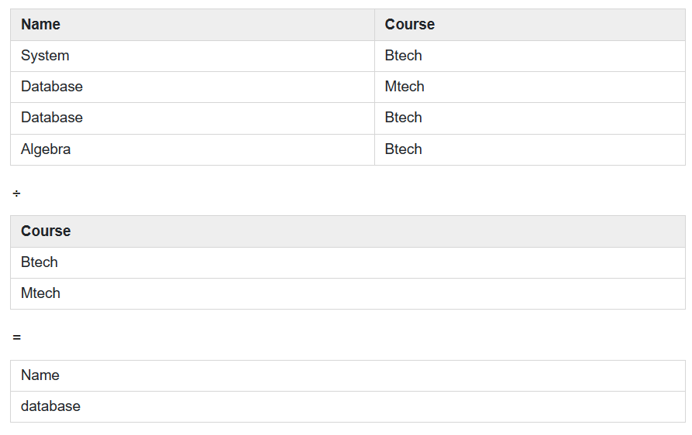

Slide 4
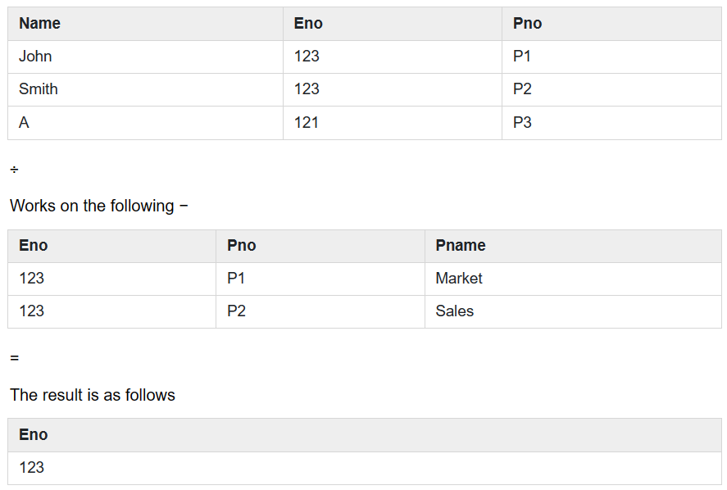
Example: Retrieve names of employees who work on all the projects that John Smith works on. Consider the Employee table given below

Slide 5
Relational Calculus
There is an alternate way of formulating queries known as Relational Calculus. Relational calculus is a non-procedural query language.
In the non-procedural query language, the user is concerned with the details of how to obtain the end results.
The relational calculus tells what to do but never explains how to do.
Most commercial relational languages are based on aspects of relational calculus including SQL-QBE (Query By Example) and QUEL (Query Language).

Slide 6
Tuple Relational Calculus (TRC)
Tuple Relational Calculus is a non-procedural query language unlike relational algebra.
Tuple Calculus provides only the description of the query but it does not provide the methods to solve it.
Thus, it explains what to do but not how to do.
In Tuple Calculus, a query is expressed as
{t| P(t)}
where t = resulting tuples, P(t) = known as Predicate and these are the conditions that are used to fetch t.

Slide 7
Thus, it generates set of all tuples t, such that Predicate P(t) is true for t.
P(t) may have various conditions logically combined with OR (∨), AND (∧), NOT(¬).
It also uses quantifiers:
∃ t ∈ r (Q(t)) = ”there exists” a tuple in t in relation r such that predicate Q(t) is true.
∀ t ∈ r (Q(t)) = Q(t) is true “for all” tuples in relation r.

